Slide 1
Properties of Enzymes
https://www.easybiologyclass.com
Catalytic Property, Specificity, Reversibility, and Sensitivity to Heat and pH
e-mail: easybiologyclass@gmail.com
admin@easybiologyclass.com
www.easybiologyclass.com

Slide 17
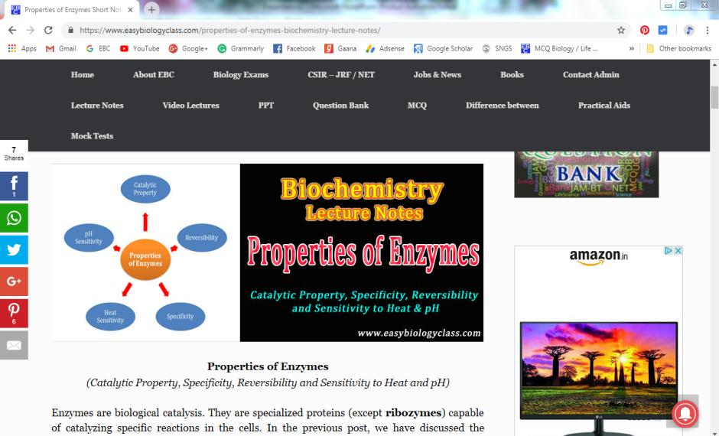
For detailed description of this topic, please click on:
https://www.easybiologyclass.com/properties-of-enzymes-biochemistry-lecture-notes/

Slide 18
Visit our website: www.easybiologyclass.com for:
Lecture notes
Video tutorials
Biology PPTs
Biology MCQs
CSIR and GATE Study Materials
Job Notifications
Question Bank
Many more…
Our sister concern: www.angiospermtaxonomy.com

Slide 19
For more, visit:
Video Tutorials
https://www.easybiologyclass.com
EasyBiologyClass
Thank You…
E-mail:
easybiologyclass@gmail.com
admin@easybiologyclass.com
visit: www.easybiologyclass.com

