Slide 1
Secretory Tissue External and Internal Secretory Tissues in Plants
www.easybiologyclass.com
e-mail: easybiologyclass@gmail.com
www.easybiologyclass.com

Slide 29
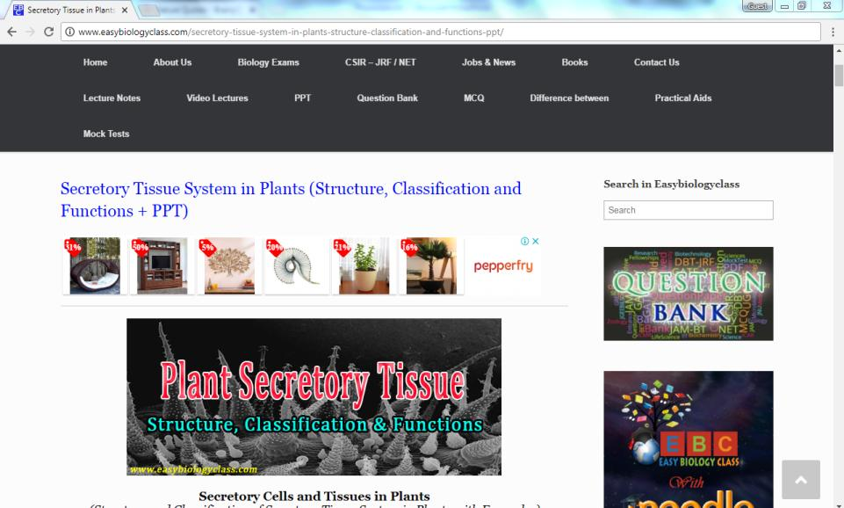
For detailed description of this topic, please click on:
http://www.easybiologyclass.com/secretory-tissue-system-in-plants-structure-classification-and-functions-ppt/

Slide 30
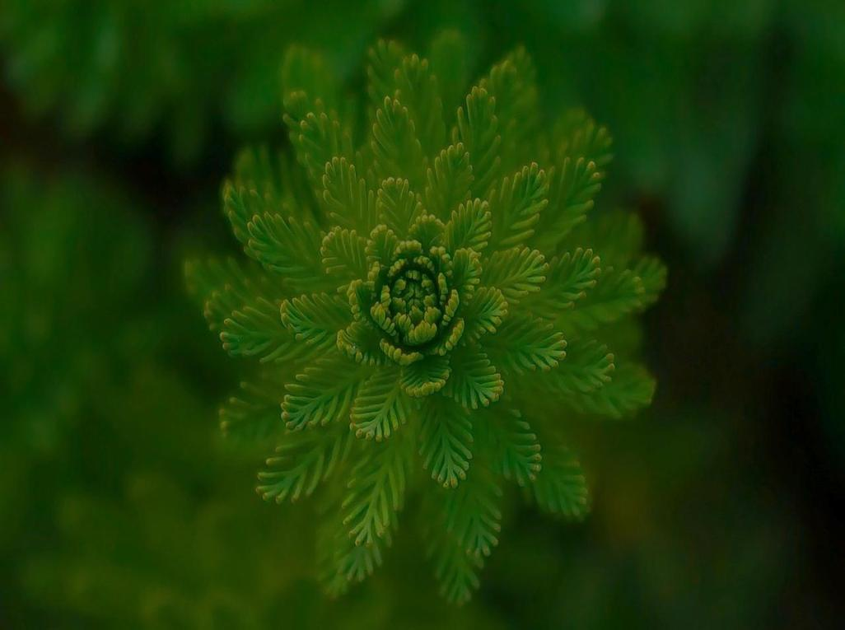
Visit our website: www.easybiologyclass.com for:
Lecture notes
Video tutorials
Biology PPTs
Biology MCQs
CSIR and GATE Study Materials
Job Notifications
Question Bank
Many more…
Our sister concern: www.angiospermtaxonomy.com

Slide 31
For more information, please log on to: www.easybiologyclass.com
For video tutorials : easybiologyclass
Thank You…
E-mail: easybiologyclass@gmail.com
visit: www.easybiologyclass.com

