Slide 2
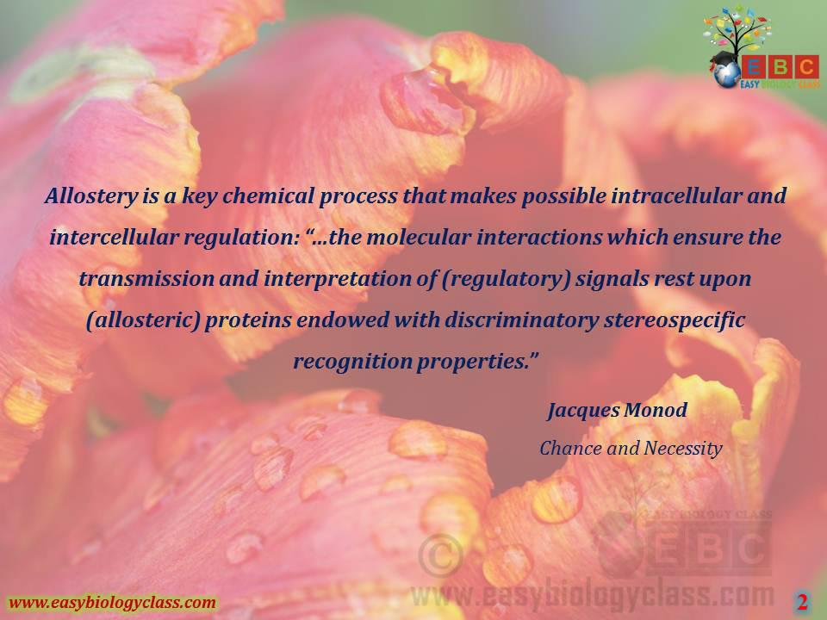

Slide 40
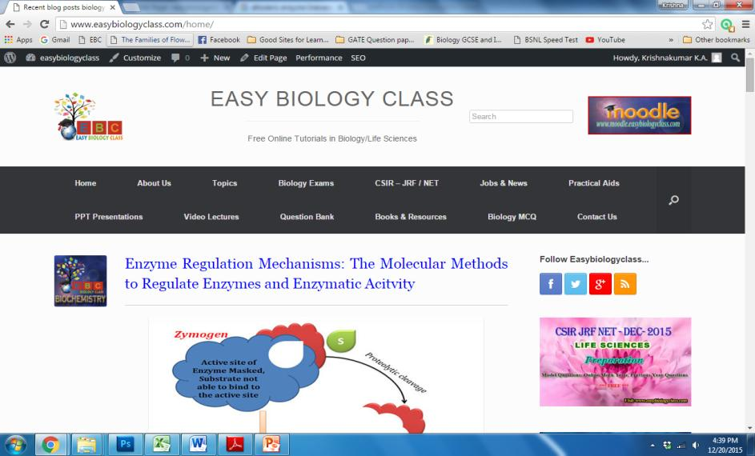
For detailed description of this topic: Enzyme regulation, Please Click on..
http://www.easybiologyclass.com/enzyme-regulation-mechanisms-molecular-methods-regulate-enzyme-enzymatic-acitvity/

Slide 41
Visit our website: www.easybiologyclass.com for:
Lecture notes
Video tutorials
Biology PPTs
Biology MCQs
CSIR and GATE Study Materials
Job Notifications
Question Bank
Many more…
Our sister concern: www.angiospermtaxonomy.com

