Slide 16
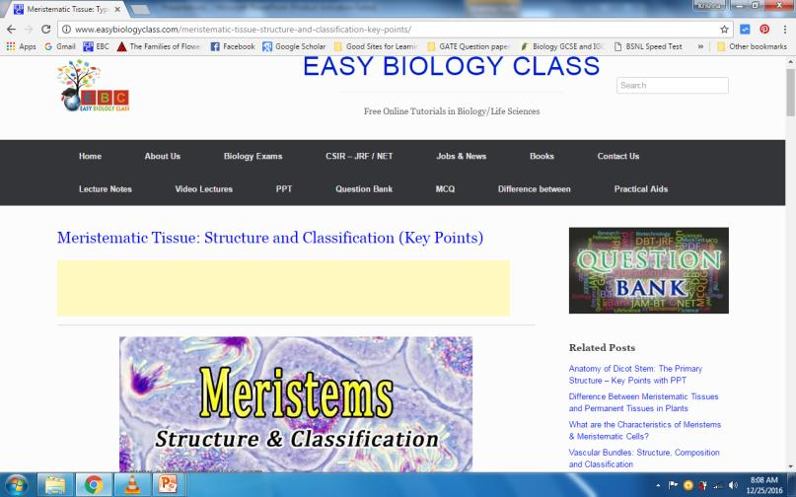
For detailed description of this topic: Please Click on..
http://www.easybiologyclass.com/meristematic-tissue-structure-and-classification-key-points/
For video tutorial (YOUTUBE): DNA Repair Introduction, Please Click on..
https://www.youtube.com/watch?v=hnBCyFpPG5c

Slide 17
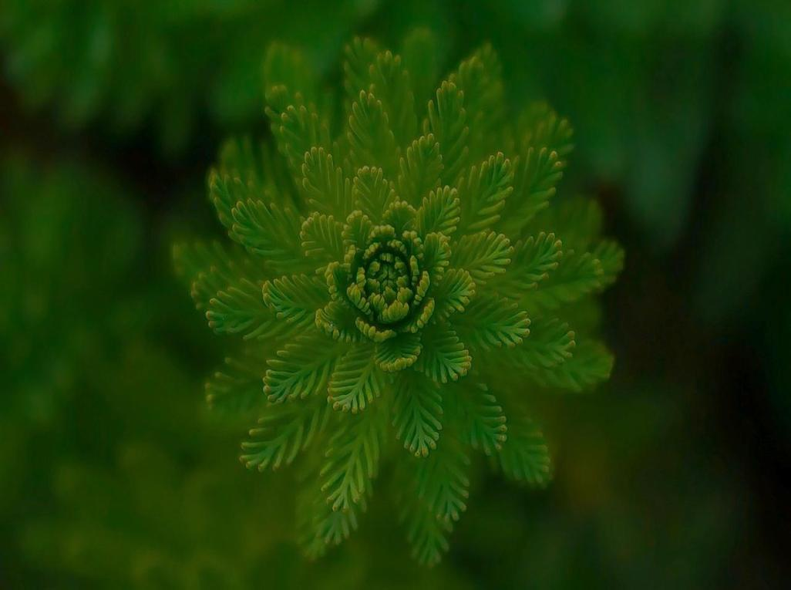
Visit our website: www.easybiologyclass.com for:
Lecture notes
Video tutorials
Biology PPTs
Biology MCQs
CSIR and GATE Study Materials
Job Notifications
Question Bank
Many more…
Our sister concern: www.angiospermtaxonomy.com

