Slide 25
For detailed description of this topic, please click on:
http://www.easybiologyclass.com/general-characters-of-gymnosperms-lecture-notes-with-ppt/

Slide 26
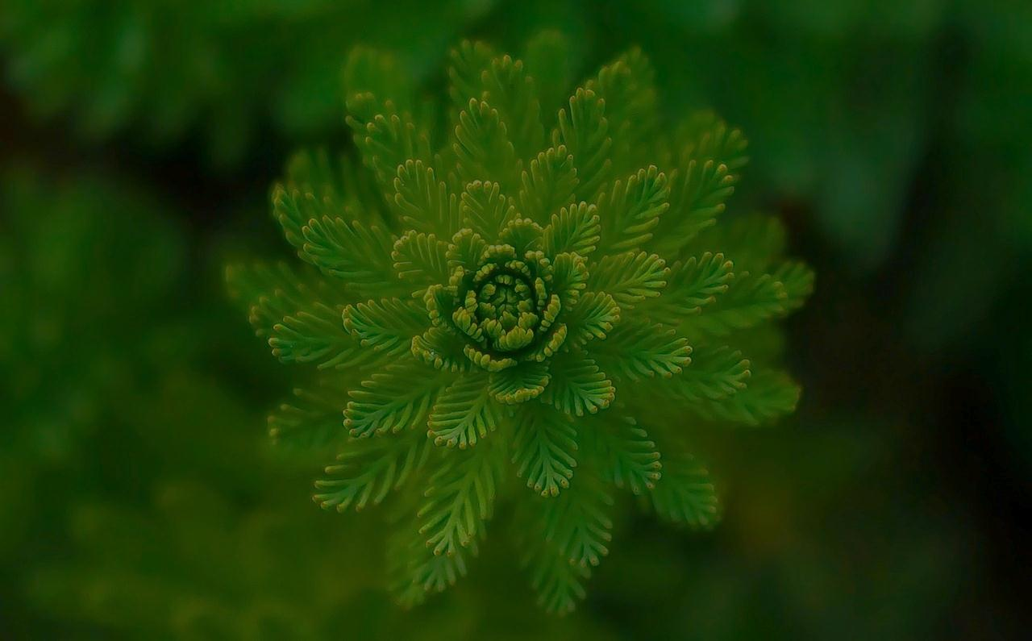
Visit our website: www.easybiologyclass.com for:
Lecture notes
Video tutorials
Biology PPTs
Biology MCQs
CSIR and GATE Study Materials
Job Notifications
Question Bank
Many more…
Our sister concern: www.angiospermtaxonomy.com

Slide 27
For more information, please log on to: www.easybiologyclass.com
For video tutorials : easybiologyclass
Thank You…
E-mail:
easybiologyclass@gmail.com
mail@easybiologyclass.com
visit: www.easybiologyclass.com

