Slide 9
For detailed description of this topic: Nucleotide Excision Repair, Please Click on..
http://www.easybiologyclass.com/nucleotide-excision-repair-ner-in-prokaryotes-dna-repair/
For video tutorial (YOUTUBE): Nucleotide Excision Repair, Please Click on..
https://youtu.be/JVpOVU2tFnA

Slide 10
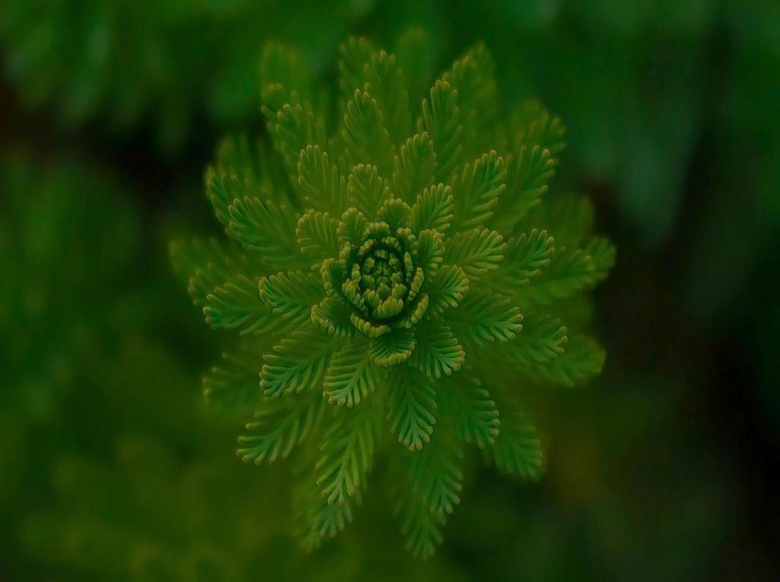
Visit our website: www.easybiologyclass.com for:
Lecture notes
Video tutorials
Biology PPTs
Biology MCQs
CSIR and GATE Study Materials
Job Notifications
Question Bank
Many more…
Our sister concern: www.angiospermtaxonomy.com

