Slide 16
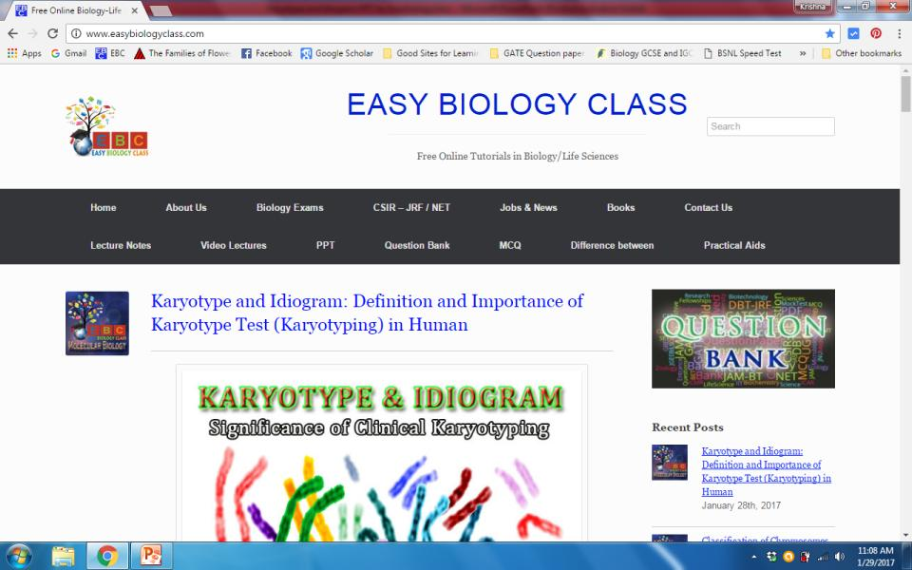
For detailed description of this topic, please click on:
http://www.easybiologyclass.com/karyotype-and-idiogram-definition-and-importance-of-karyotype-test-karyotyping-in-human/

Slide 17
Visit our website: www.easybiologyclass.com for:
Lecture notes
Video tutorials
Biology PPTs
Biology MCQs
CSIR and GATE Study Materials
Job Notifications
Question Bank
Many more…
Our sister concern: www.angiospermtaxonomy.com

Slide 18
For more information, please log on to: www.easybiologyclass.com
For video tutorials please subscribe the YouTube channel: easybiologyclass
Thank You…
E-mail us @:
easybiologyclass@gmail.com
mail@easybiologyclass.com
visit: www.easybiologyclass.com

