Slide 1


Introduction to Genetics
(Terminologies in Genetics)
www.easybiologyclass.com
e-mail: easybiologyclass@gmail.com
mail@easybiologyclass.com
www.easybiologyclass.com

Slide 2


Slide 3
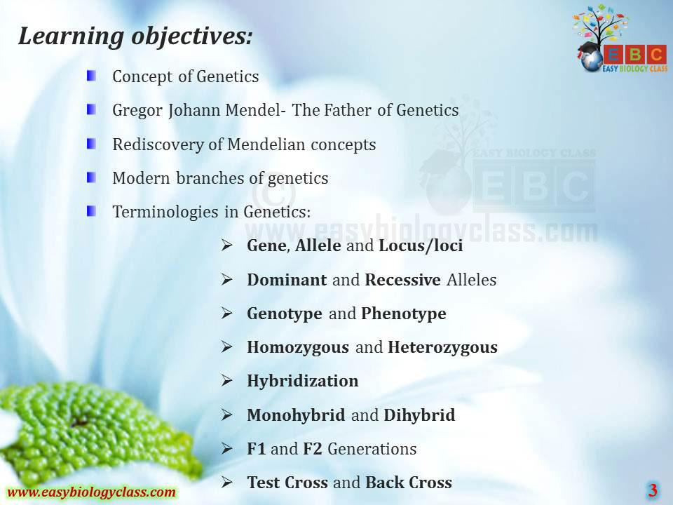

Slide 4
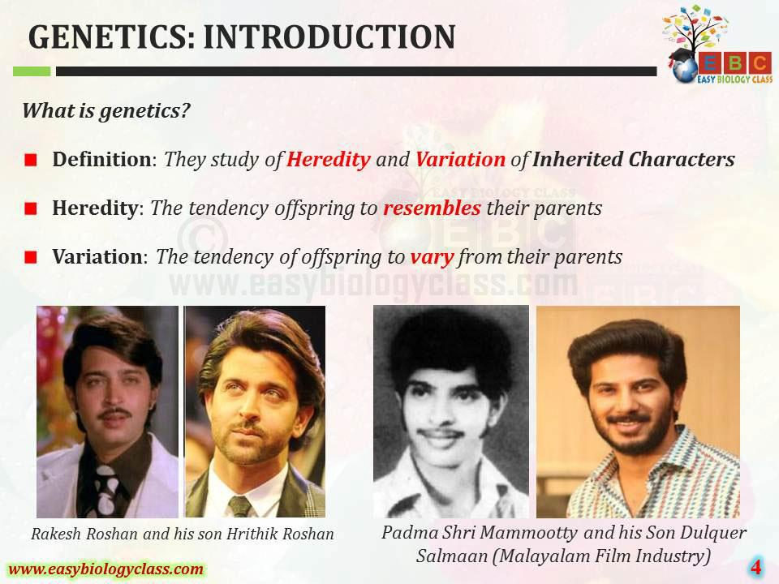

Slide 5
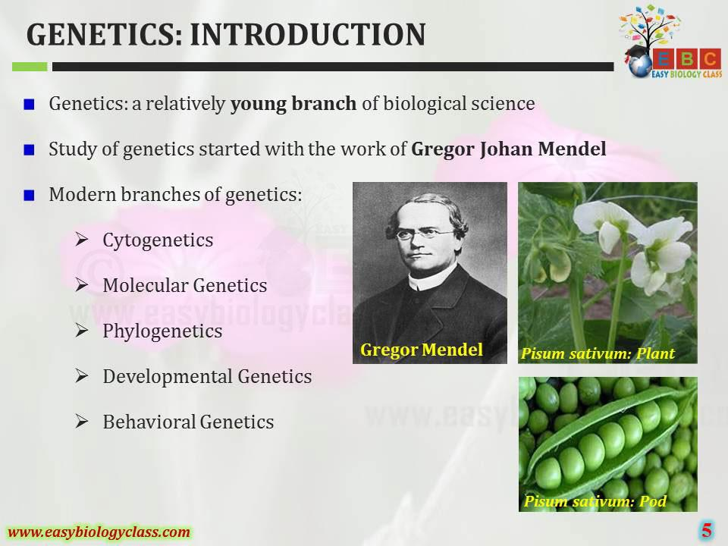

Slide 6
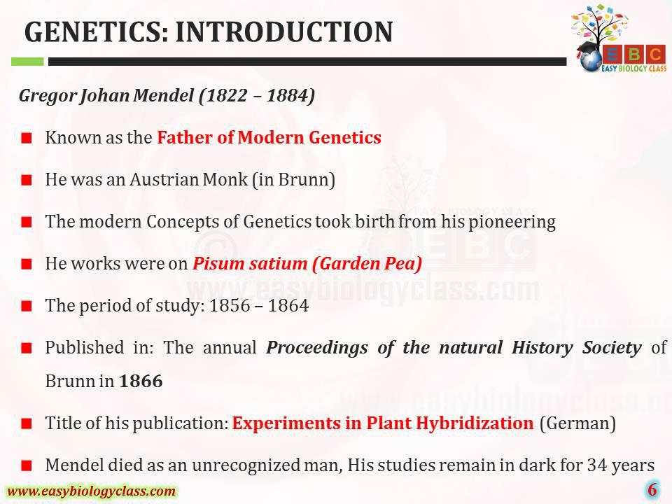

Slide 7
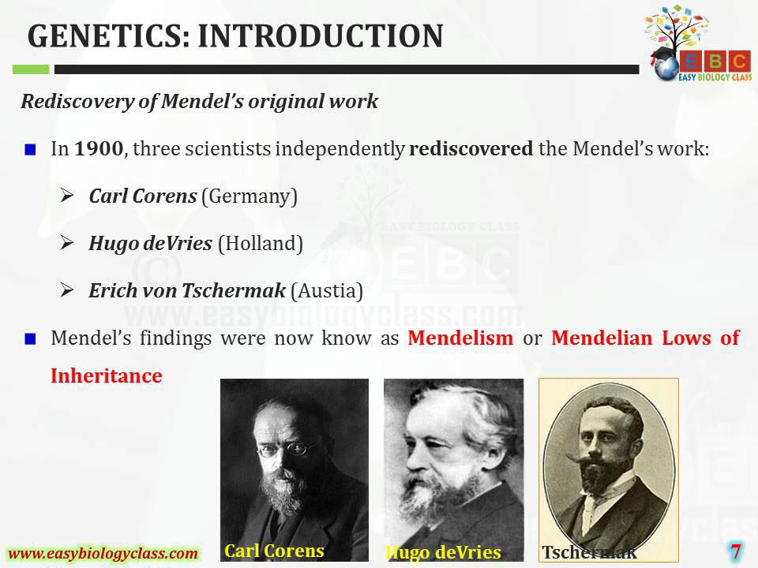

Slide 8
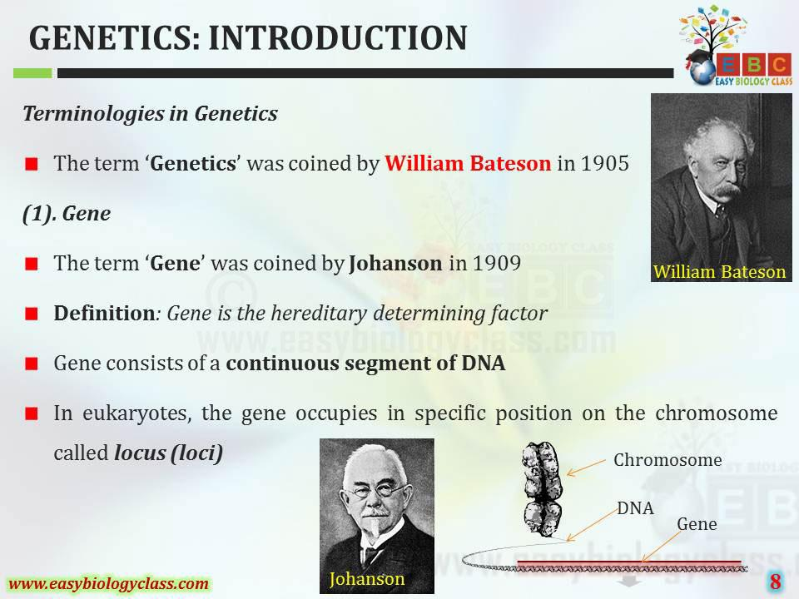

Slide 9
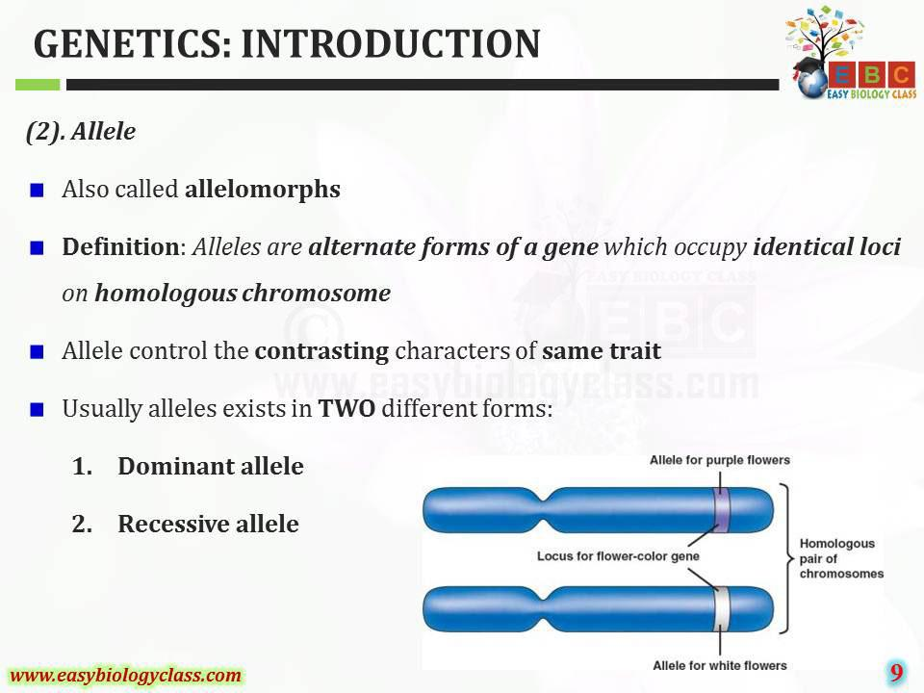

Slide 10
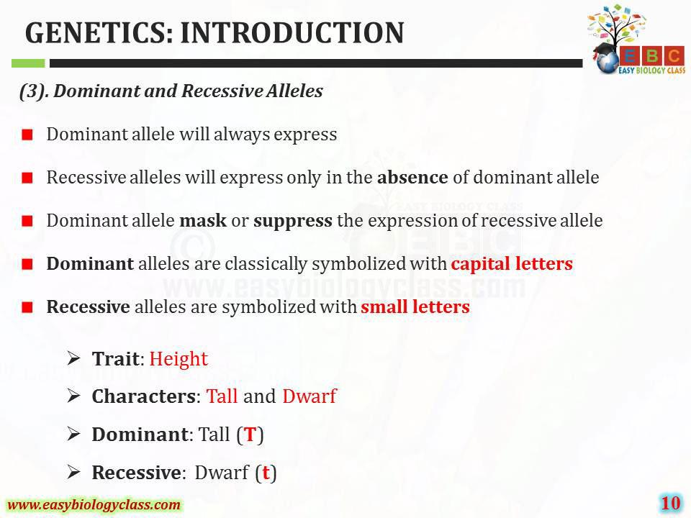

Slide 11
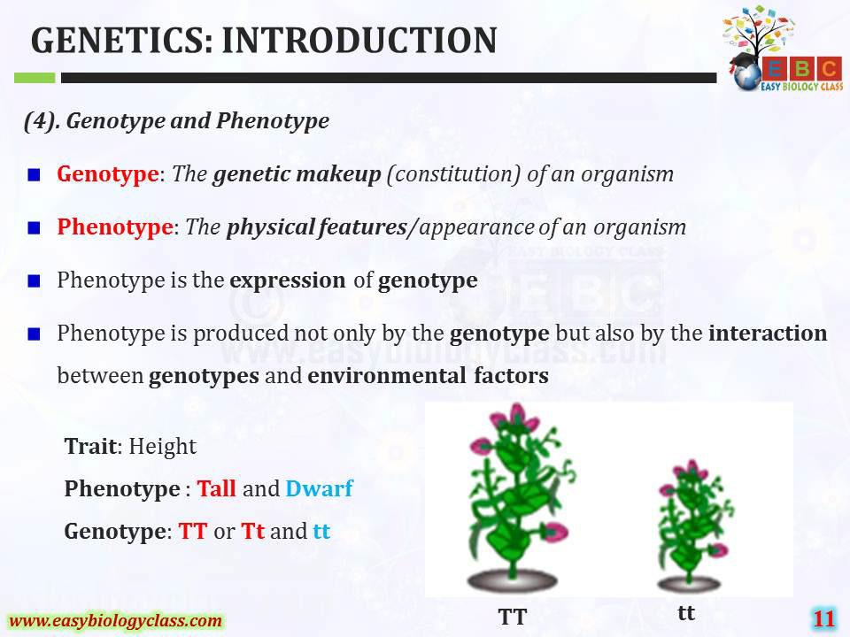

Slide 12
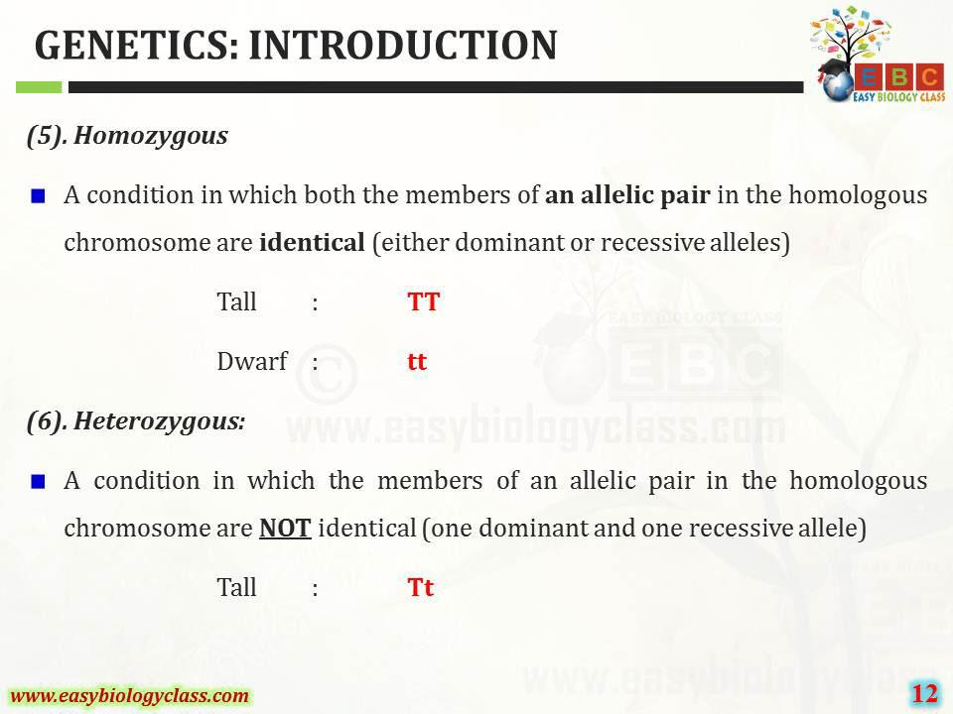

Slide 13
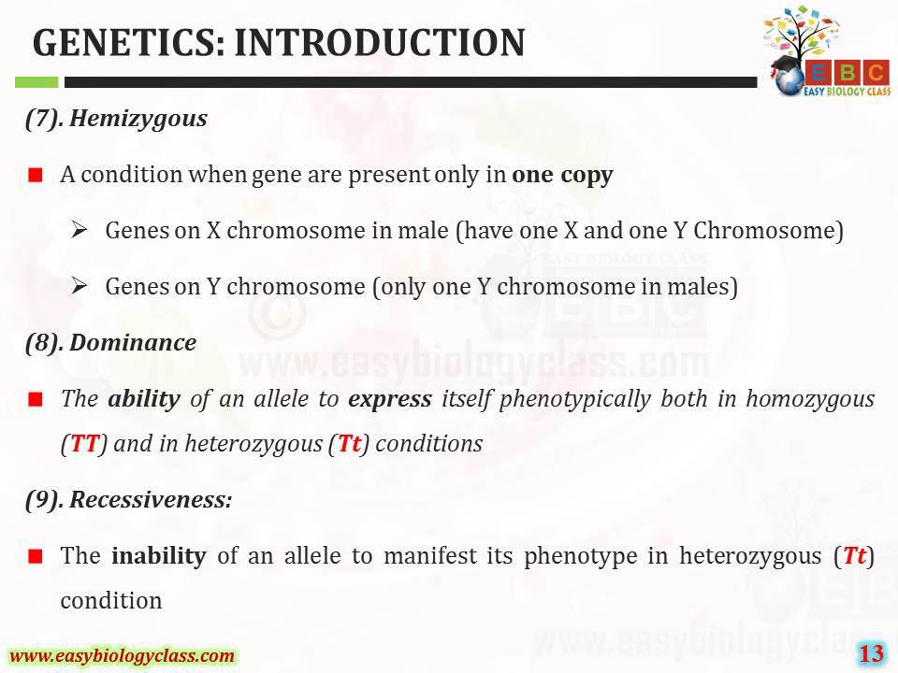

Slide 14
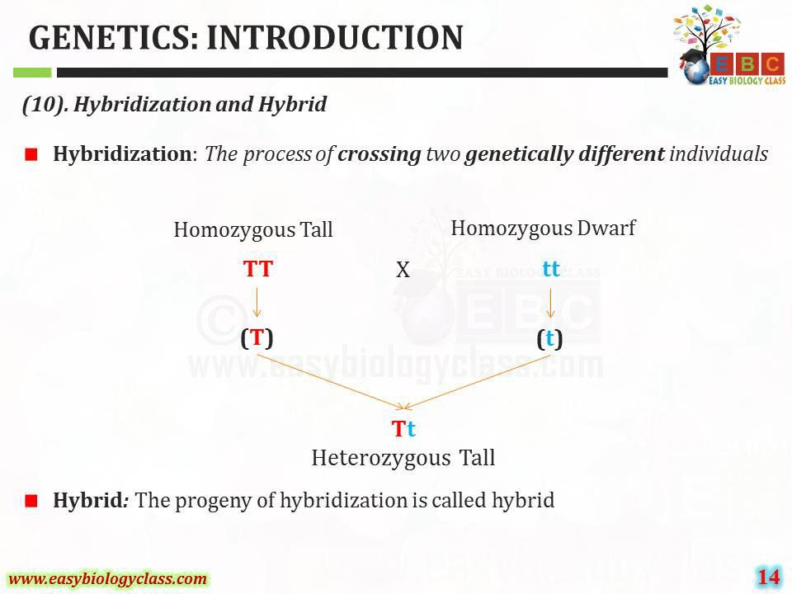

Slide 15
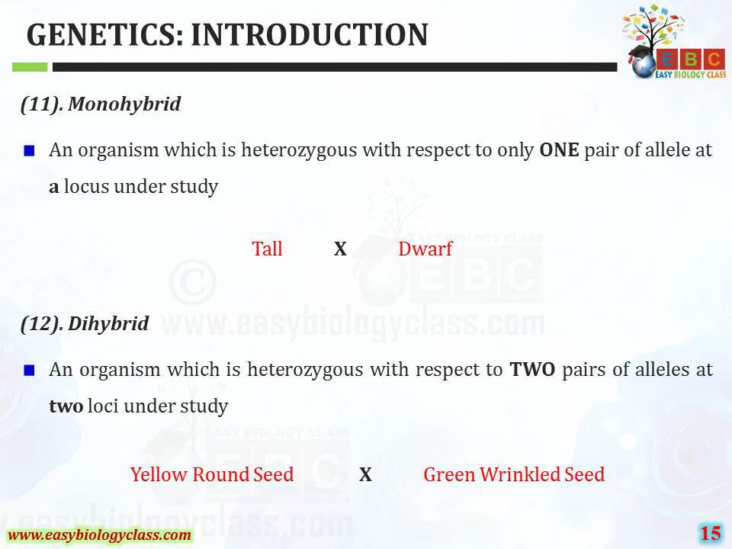

Slide 16
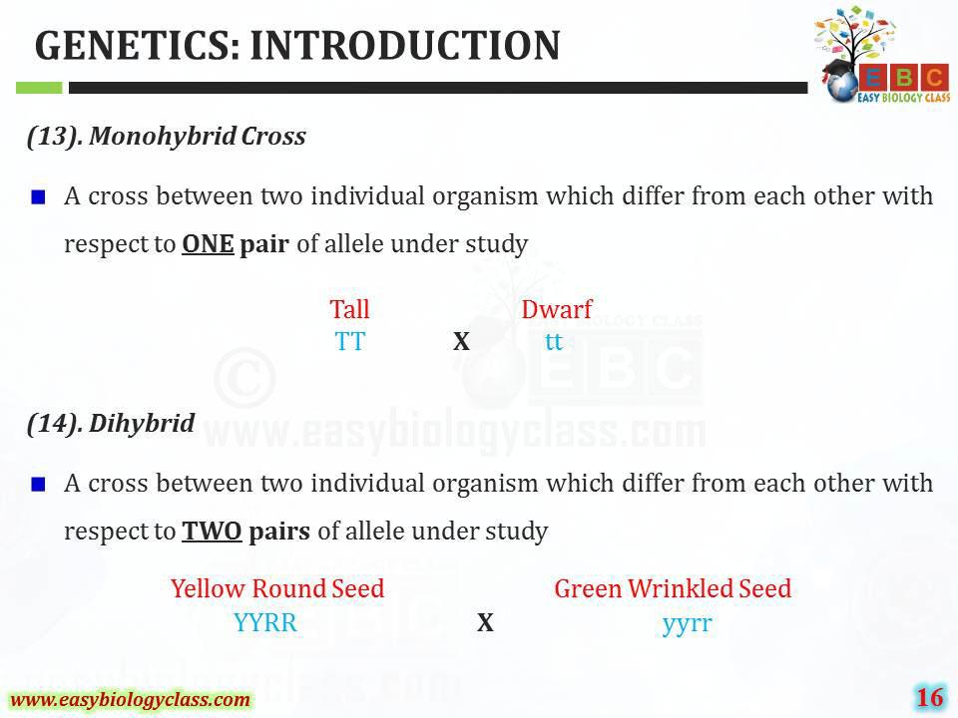

Slide 17
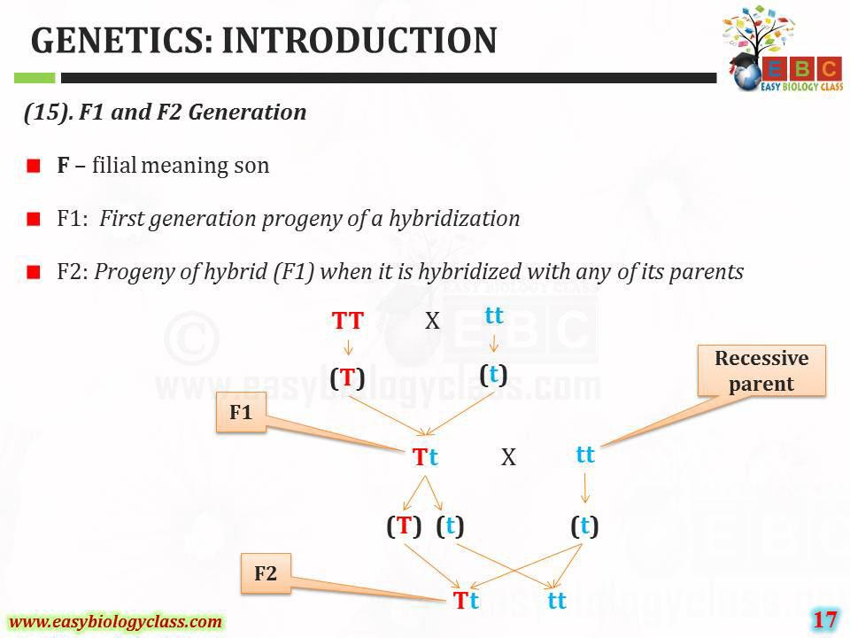

Slide 18
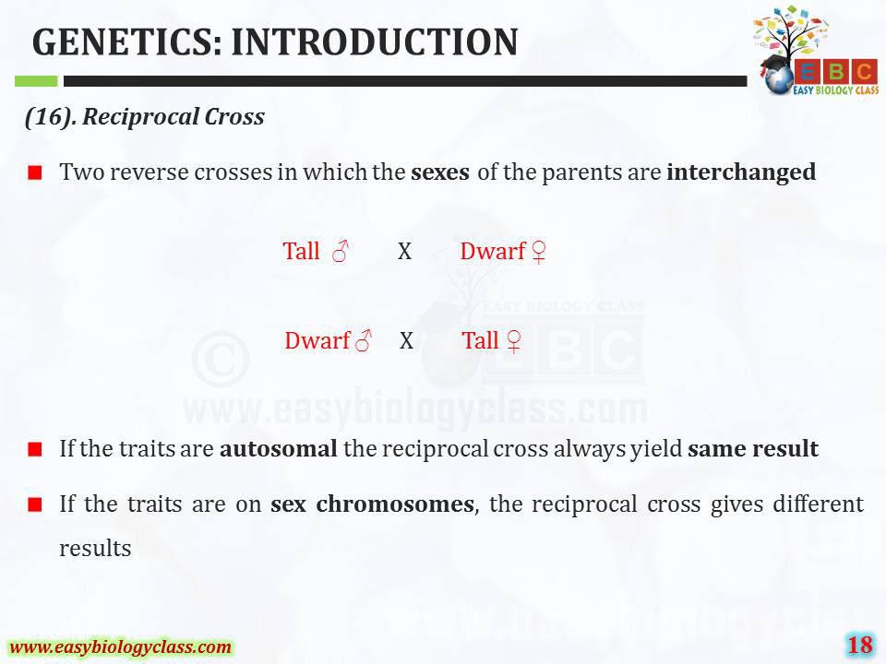

Slide 19
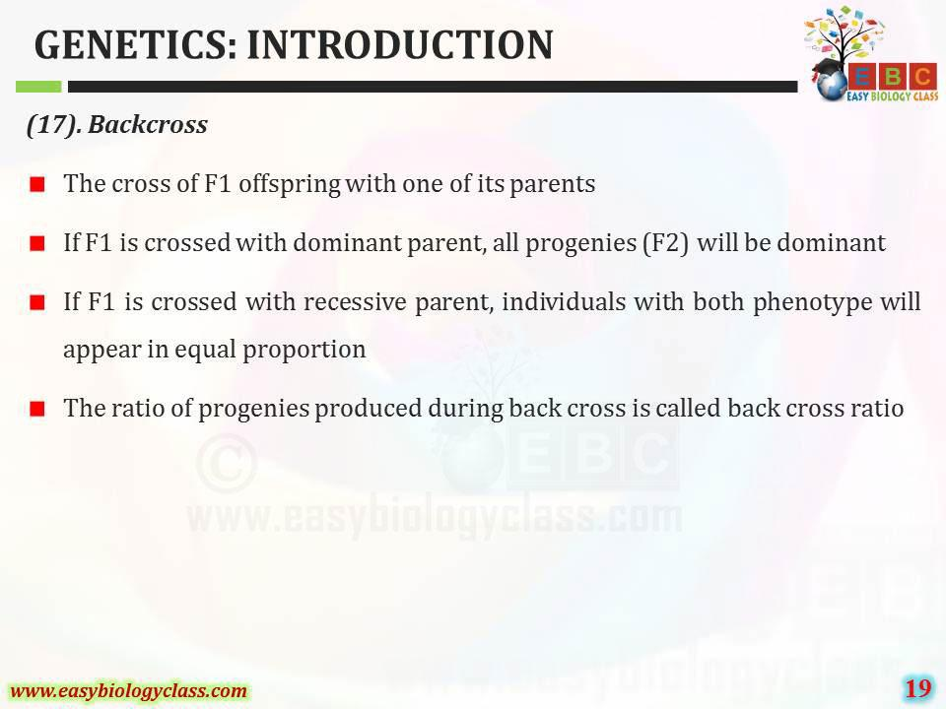

Slide 20
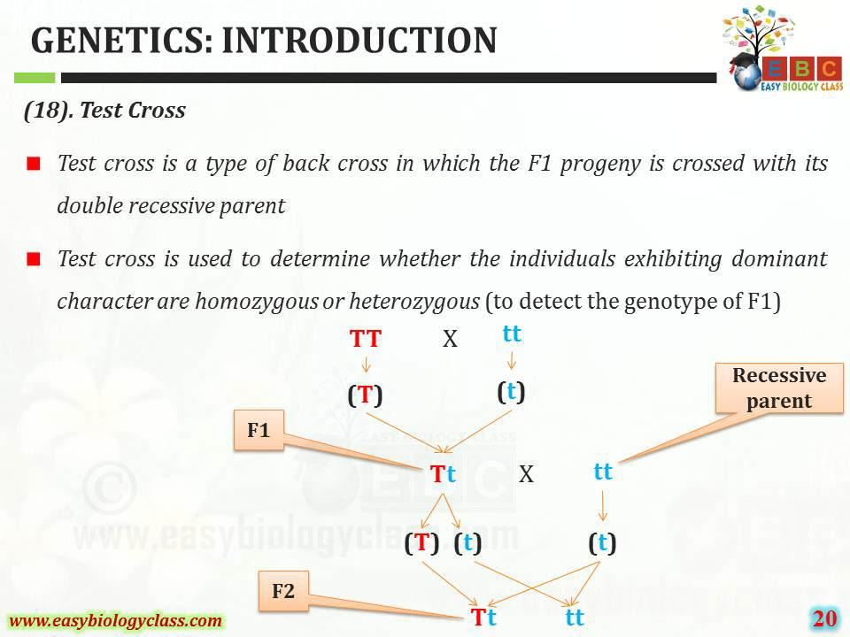

Slide 21

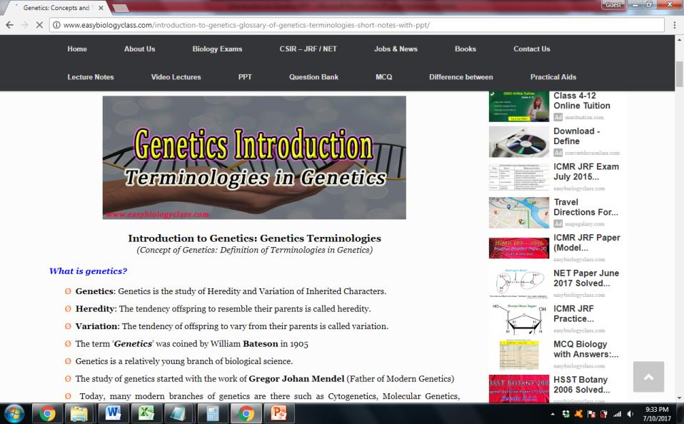
For detailed description of this topic, please click on:
http://www.easybiologyclass.com/introduction-to-genetics-glossary-of-genetics-terminologies-short-notes-with-ppt/

Slide 22



Visit our website: www.easybiologyclass.com for:
  Lecture notes
  Video tutorials
  Biology PPTs
  Biology MCQs
  CSIR and GATE Study Materials
  Job Notifications
  Question Bank
  Many more…
Our sister concern: www.angiospermtaxonomy.com

Slide 23



For more information, please log on to: www.easybiologyclass.com
For video tutorials : easybiologyclass
Download PPT :
Thank You…
E-mail:
easybiologyclass@gmail.com
mail@easybiologyclass.com
visit: www.easybiologyclass.com

