Slide 13
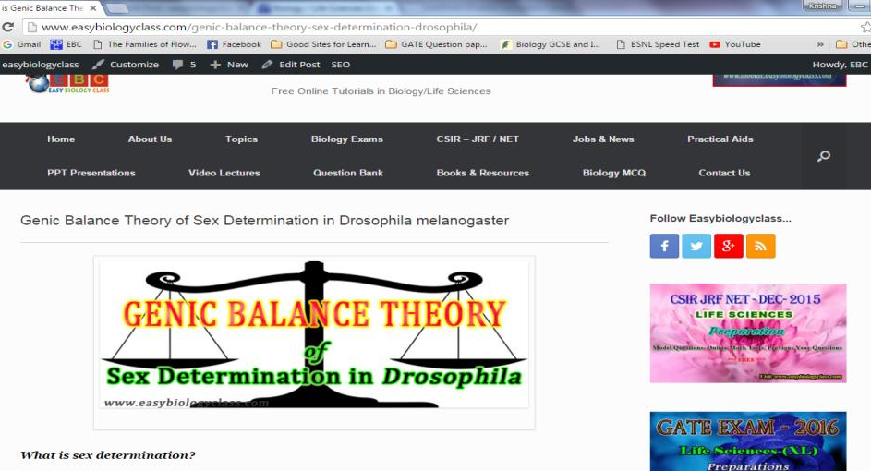
For detailed description of this topic: Please Click on..
http://www.easybiologyclass.com/genic-balance-theory-sex-determination-drosophila/

Slide 14
Visit our website: www.easybiologyclass.com for:
Lecture notes
Video tutorials
Biology PPTs
Biology MCQs
CSIR and GATE Study Materials
Job Notifications
Question Bank
Many more…
Our sister concern: www.angiospermtaxonomy.com

