Slide 20
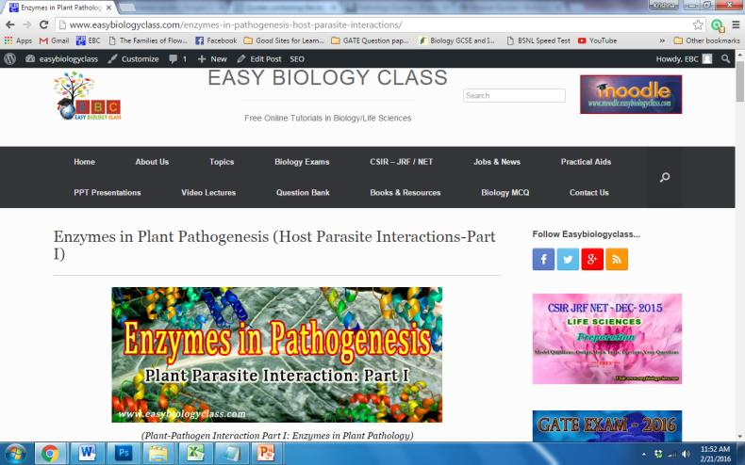
For detailed description of this topic: Please Click on..
http://www.easybiologyclass.com/enzymes-in-pathogenesis-host-parasite-interactions/

Slide 21
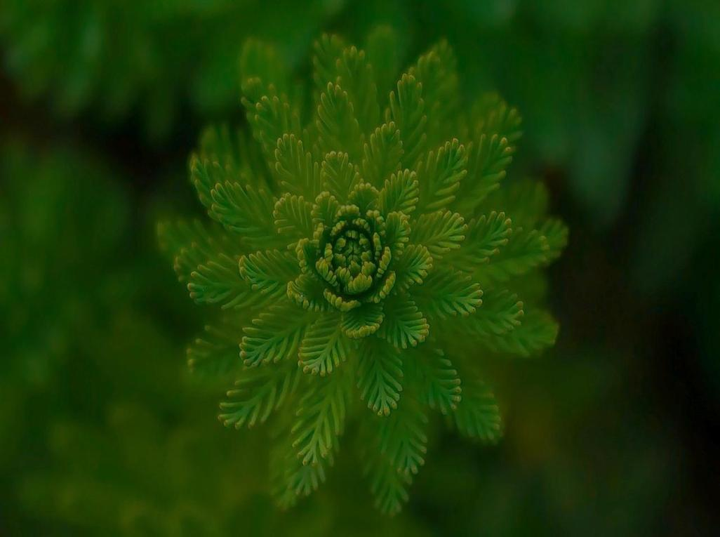
Visit our website: www.easybiologyclass.com for:
Lecture notes
Video tutorials
Biology PPTs
Biology MCQs
CSIR and GATE Study Materials
Job Notifications
Question Bank
Many more…
Our sister concern: www.angiospermtaxonomy.com

