Slide 26
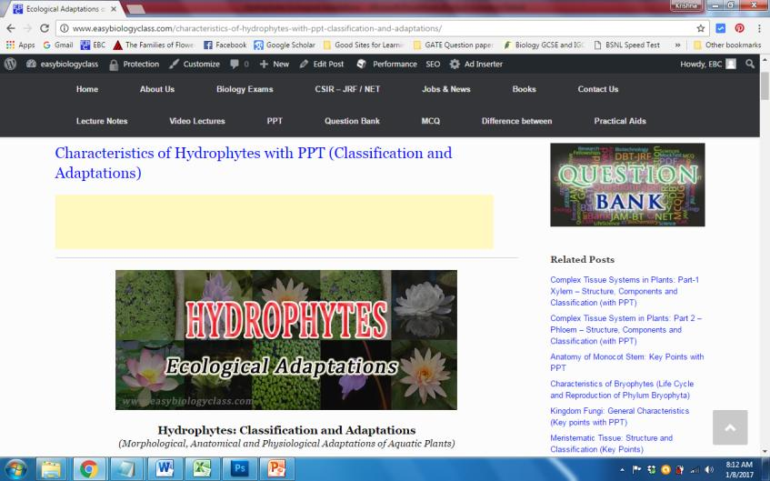
For detailed description of this topic:, Please Click on..
http://www.easybiologyclass.com/characteristics-of-hydrophytes-with-ppt-classification-and-adaptations/

Slide 27
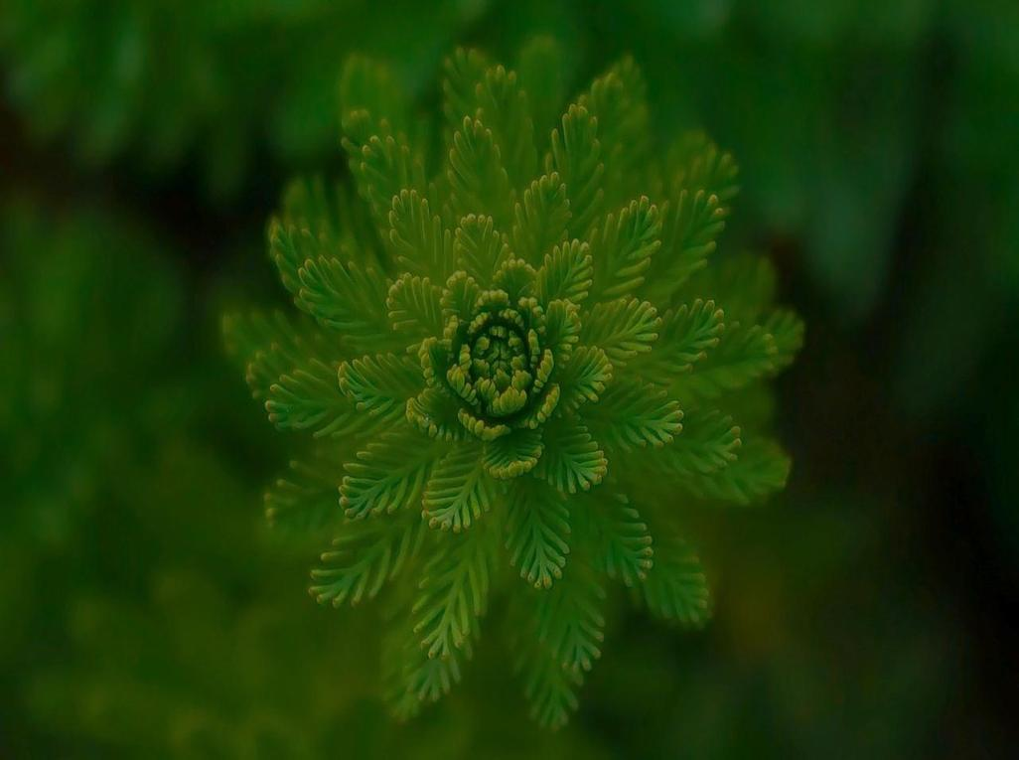
Visit our website: www.easybiologyclass.com for:
Lecture notes
Video tutorials
Biology PPTs
Biology MCQs
CSIR and GATE Study Materials
Job Notifications
Question Bank
Many more…
Our sister concern: www.angiospermtaxonomy.com

