Slide 30
For detailed description of this topic: kkkkkkkk, Please Click on..
For video tutorial (YOUTUBE): DNA Repair Introduction, Please Click on..
https://www.youtube.com/watch?v=hnBCyFpPG5c

Slide 32
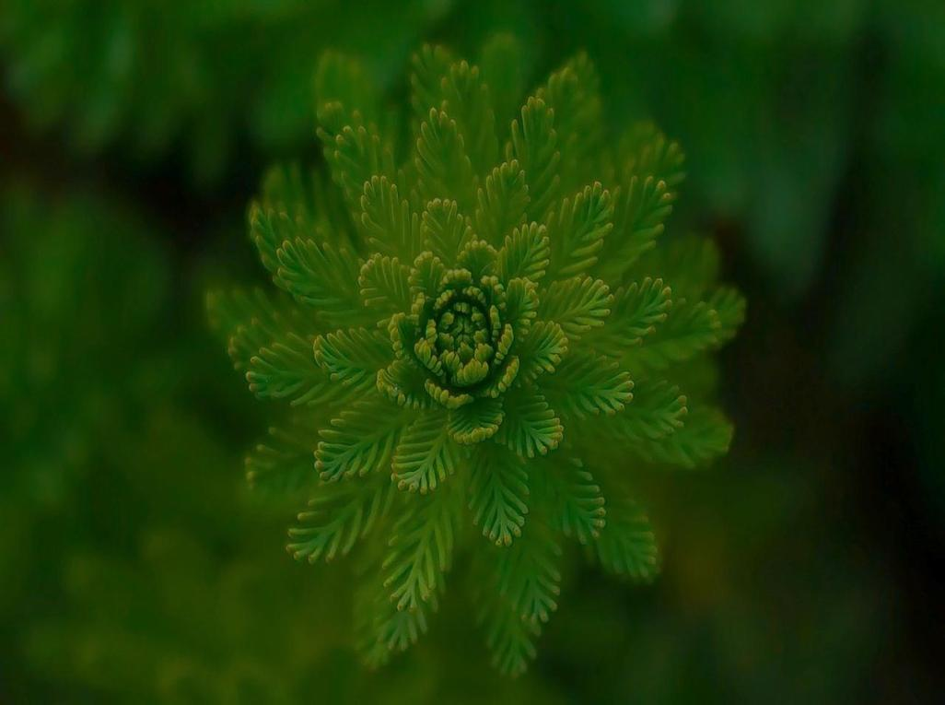
Visit our website: www.easybiologyclass.com for:
Lecture notes
Video tutorials
Biology PPTs
Biology MCQs
CSIR and GATE Study Materials
Job Notifications
Question Bank
Many more…
Our sister concern: www.angiospermtaxonomy.com

